Slide 1
Part II - Integrating Occupancy Simulator with OpenStudio

Slide 2
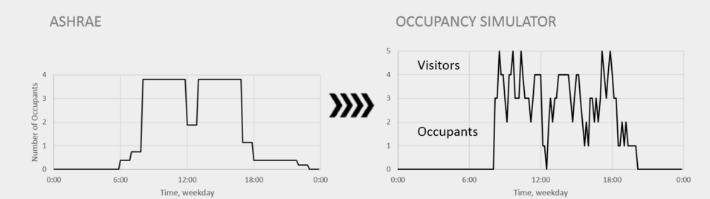
Occupancy Simulator - Background
Occupant schedule is crucial to building energy simulation
Simplified occupant schedules lack diversity and stochastics
Occupancy Simulator:
A web application running on multiplatform and devices – OccupancySimulator.lbl.gov
Uses Markov Chain model to simulate movement of each occupant
A simple and hierarchy way to organize user input
Produces occupant schedules for spaces and individual occupants
Downloadable schedules in csv and IDF files

Slide 3
Approaches | Pros | Cons
Web service | No need to download exe into local machine Automatically updated in the server No need to cover multiple platforms | Hosting needs resources Needs Internet connection The megabyte-size result file needs to be transferred back from the server, speed could be an issue Queueing system/management of users and loads need to be developed Most OS measures are not web-based, need more testing
Standalone exe | Local, no hosting need No need of Internet No need of external library Faster data transfer on local machine | Exe in multiple platforms (Windows and Linux available, Mac tbd) The exe file has to be downloaded to user’s local machine Exe needs to be tested on different versions of Windows
Compiled into OpenStudio | No need to call external web service or download specific version of exe file to local machine | IP issue Maintenance

Slide 4
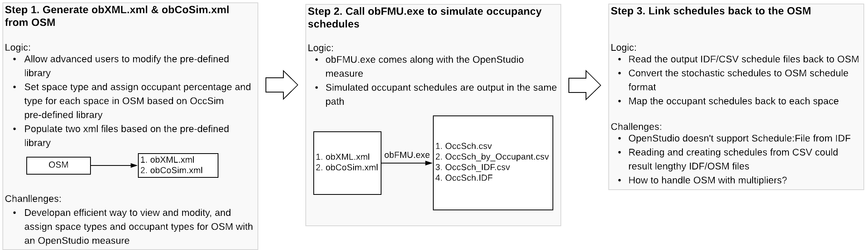
Steps of the Integration

Slide 5
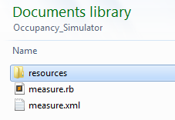
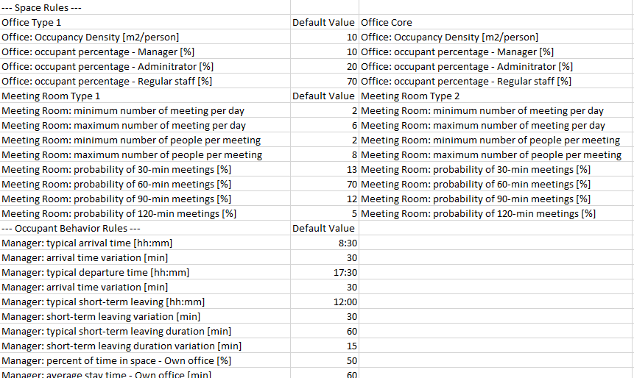
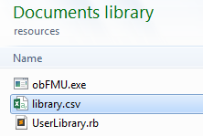
Implementation – Define space and occupancy rules

Slide 6
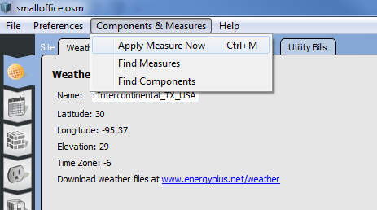
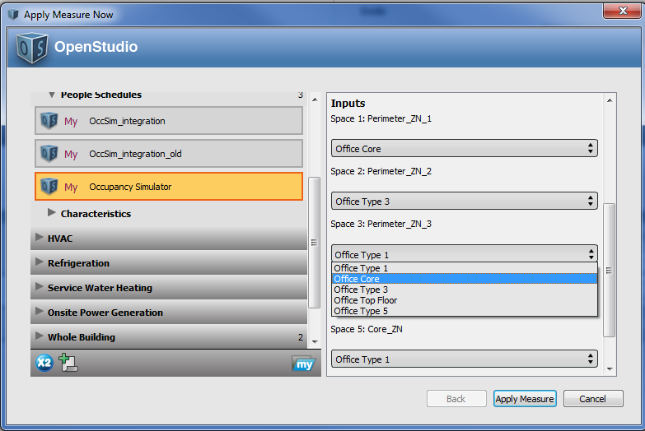
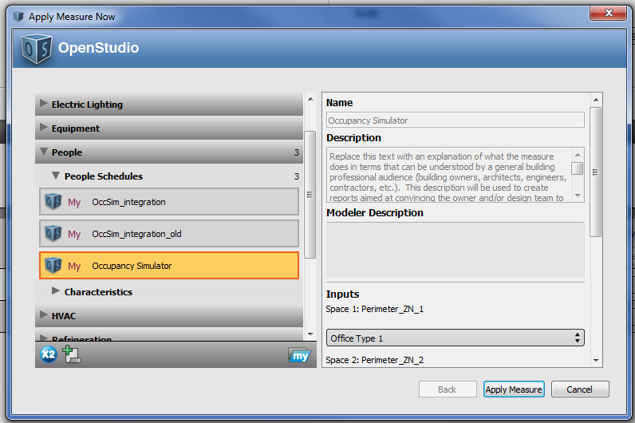
Implementation – Apply measure approach 1

Slide 7
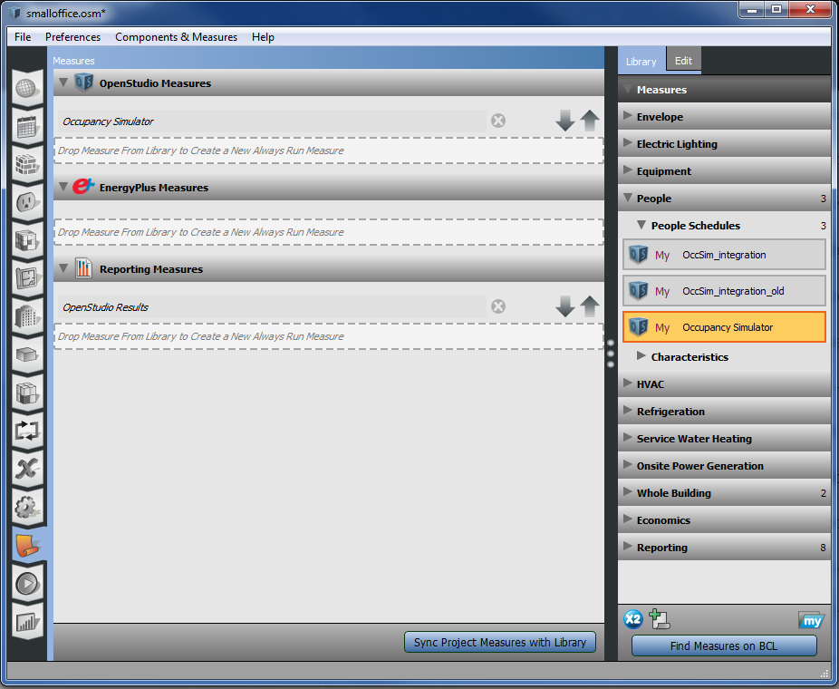
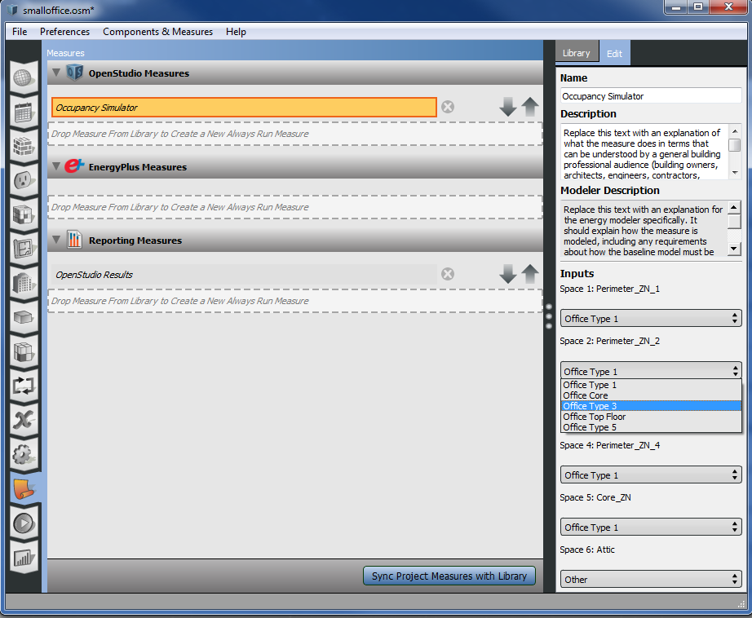
Implementation – Apply measure approach 2
3
2
4
1

